Slide 1
Database Systems – Campus Eats
Group 7:
Sanket Gaikwad
Hanisha Shaik
Rishitha Reddy Gaddam
Akhila Sirikonda

Slide 2
Contents
Project Introduction
EERD
Existing tables
New Tables
Stored Procedures
Views
Functions
Indexes

Slide 3
Project Introduction
Food delivery system for on-campus students
Hygiene consideration for food delivery during Covid times
Seamless ways of delivery methods
Increment in on-campus employment option
Project extension work: Rating tables, Stored procedures, Functions, etc.

Slide 4
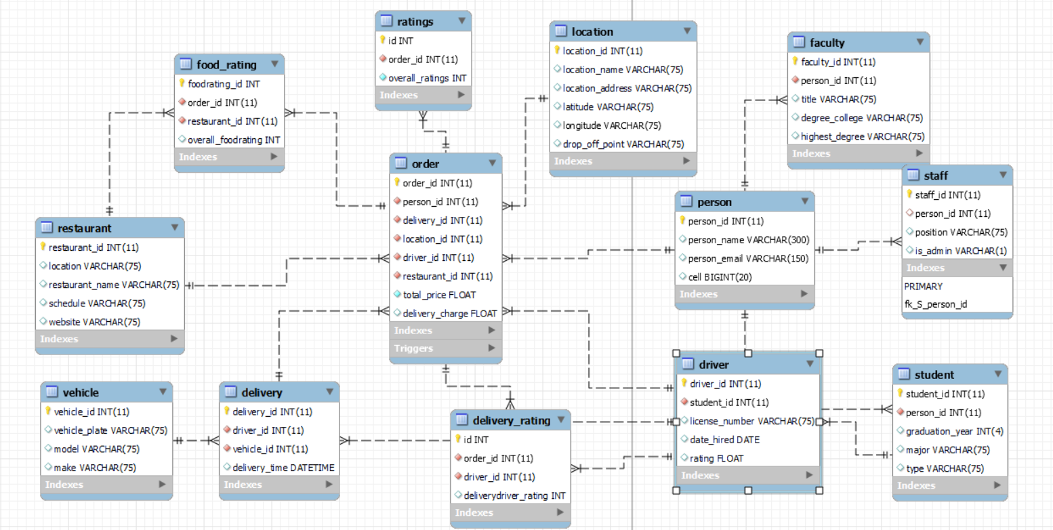
EERD

Slide 5
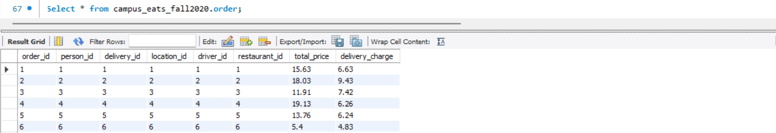
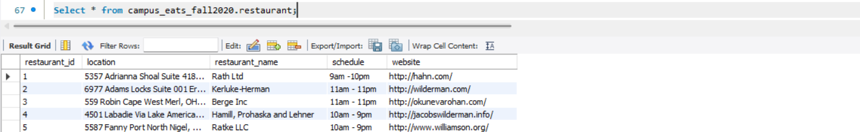
Existing tables:
1. Order table:
2. Restaurant table:

Slide 6
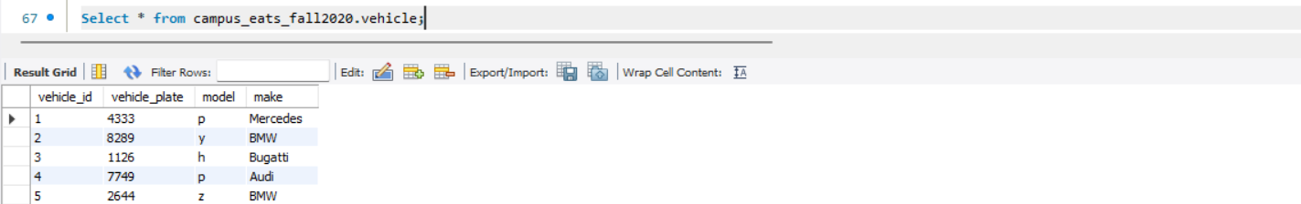
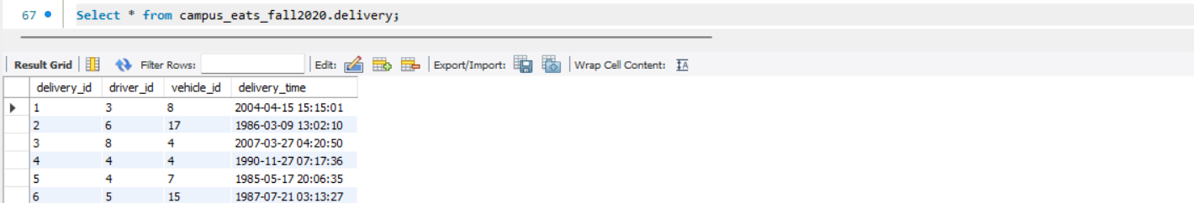
Existing tables:
3. Vehicle table:
4. Delivery table:

Slide 7
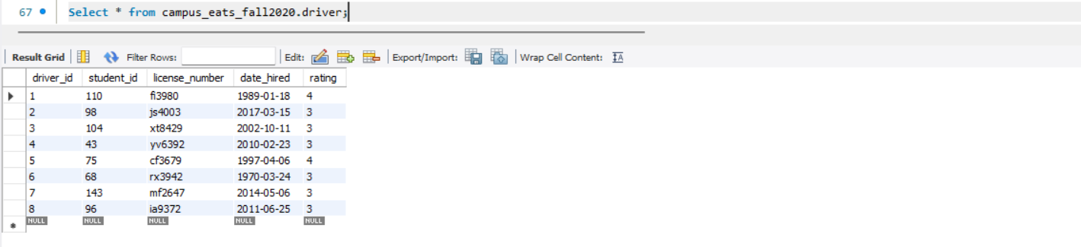
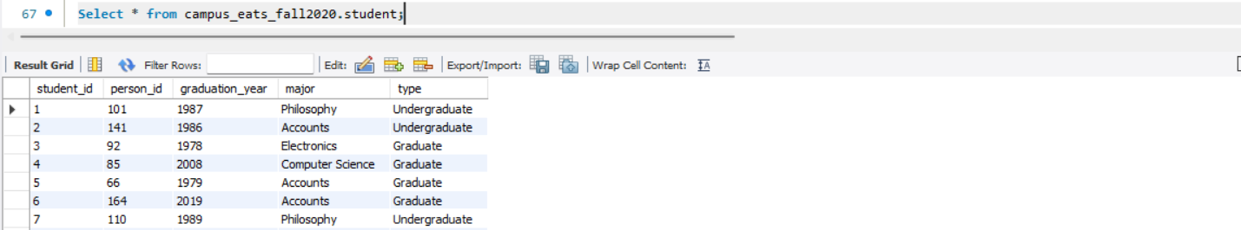
Existing tables:
5. Driver table:
6. Student table:

Slide 8
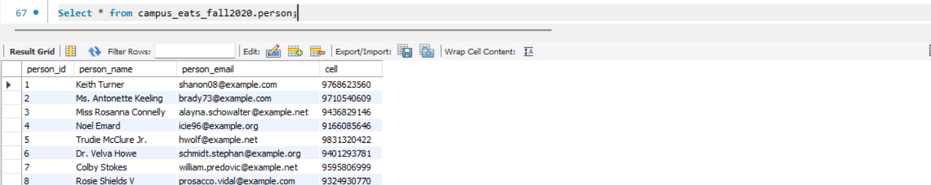
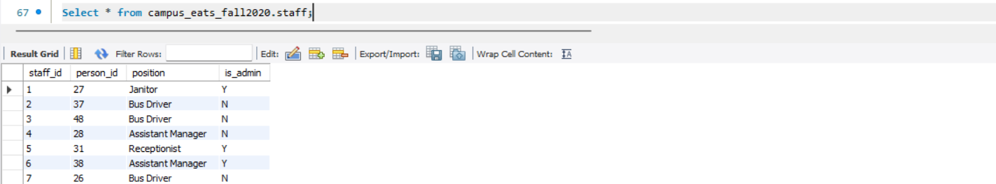
Existing tables:
7. Person table:
8. Staff table:

Slide 9
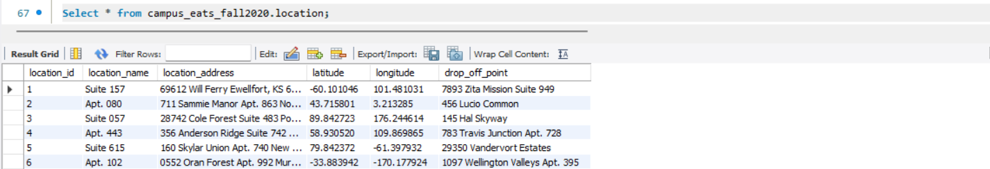
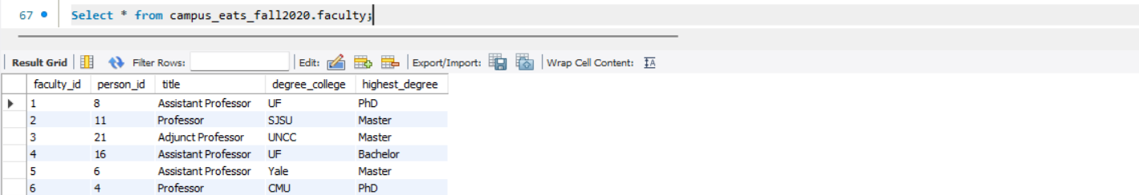
Existing tables:
9. Location table:
10. Faculty table:

Slide 10
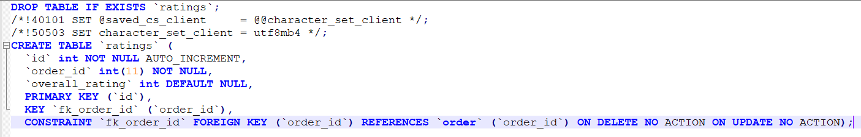
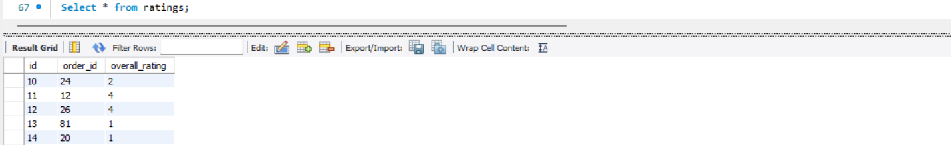
New Tables
1. Ratings table:
Table content:

Slide 11
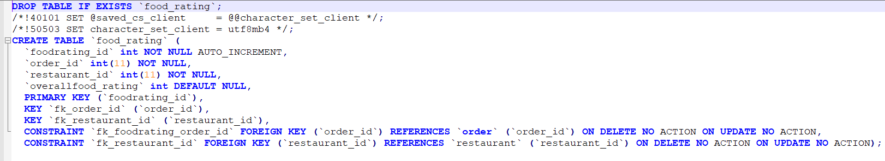
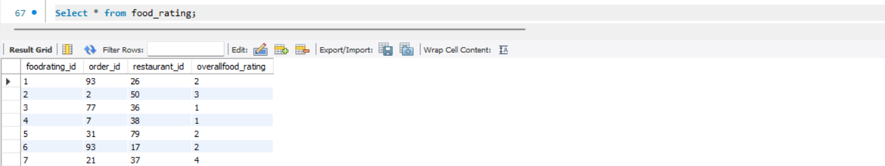
New Tables
2. Food Ratings table:
Table content:

Slide 12
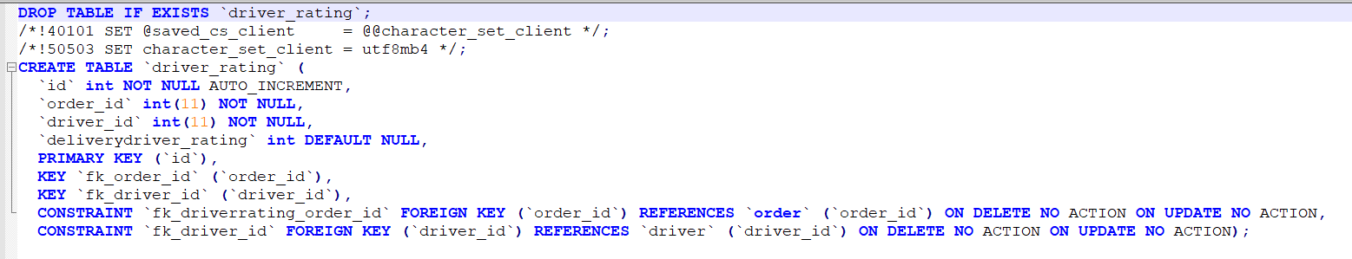
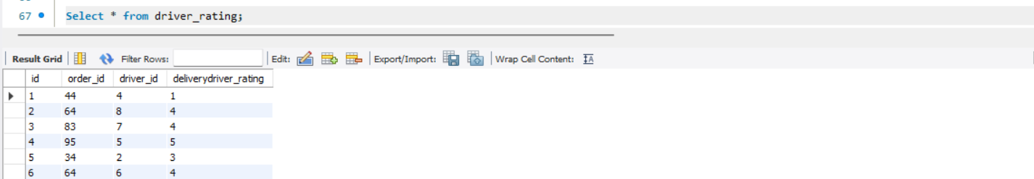
New Tables
3. Driver Ratings table:
Table content:

Slide 13
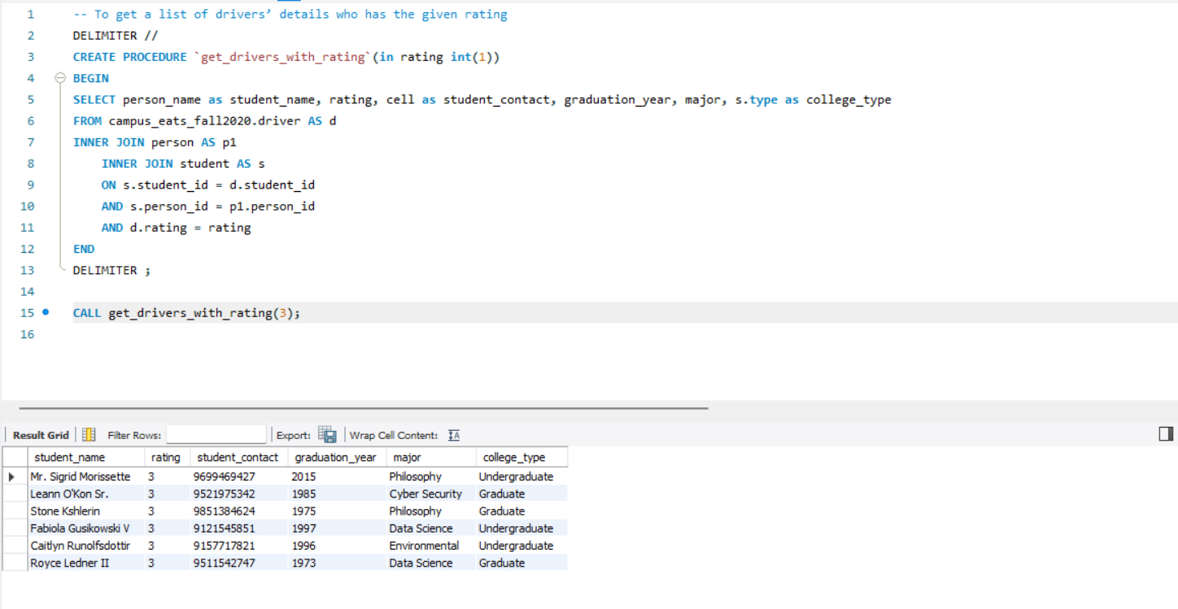
Stored Procedures
1. For driver’s rating:

Slide 14
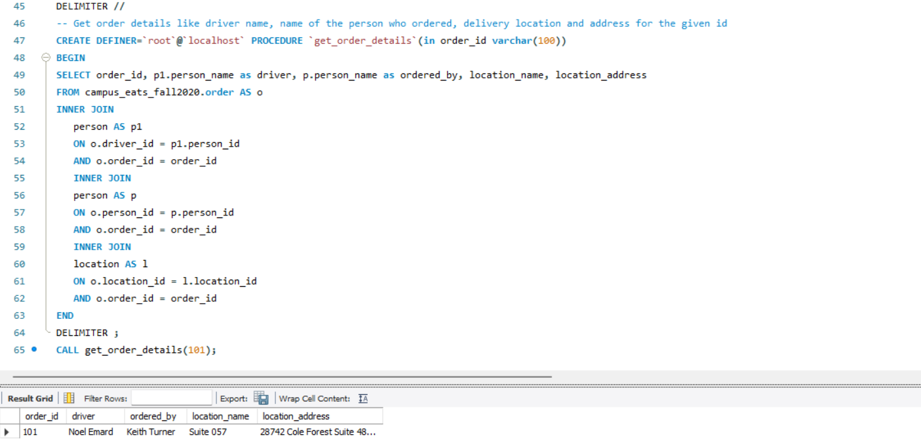
Stored Procedures
2. To get the order details:

Slide 15
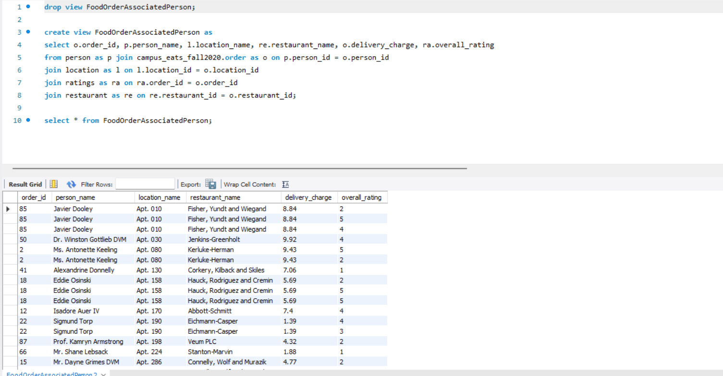
Views:
1. For food associated with each person:

Slide 16
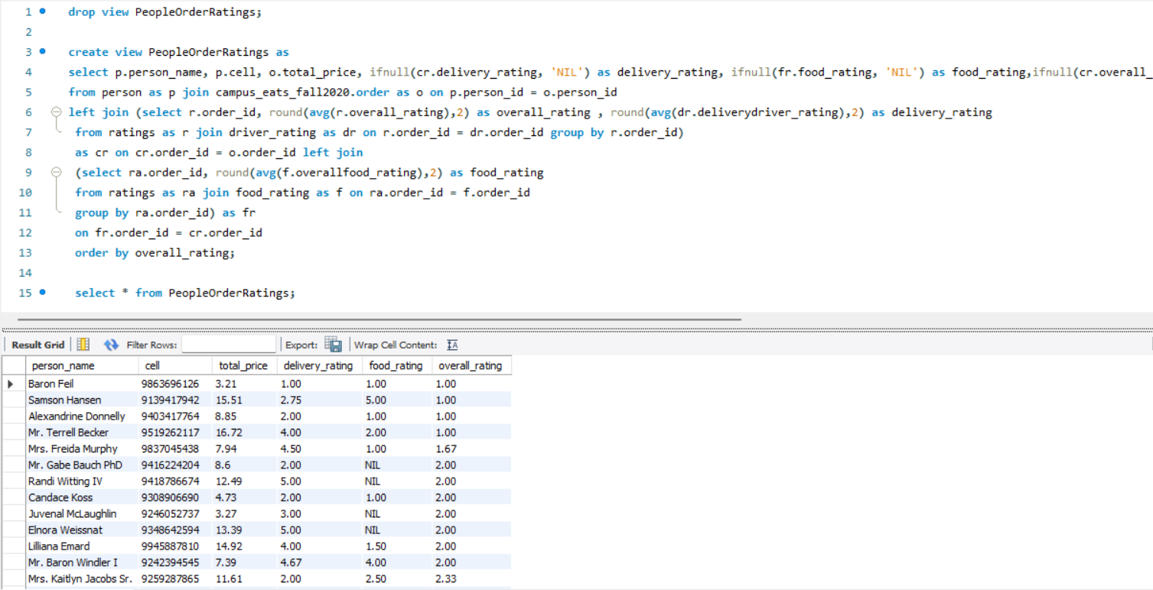
Views:
2. For people’s order rating:

Slide 17
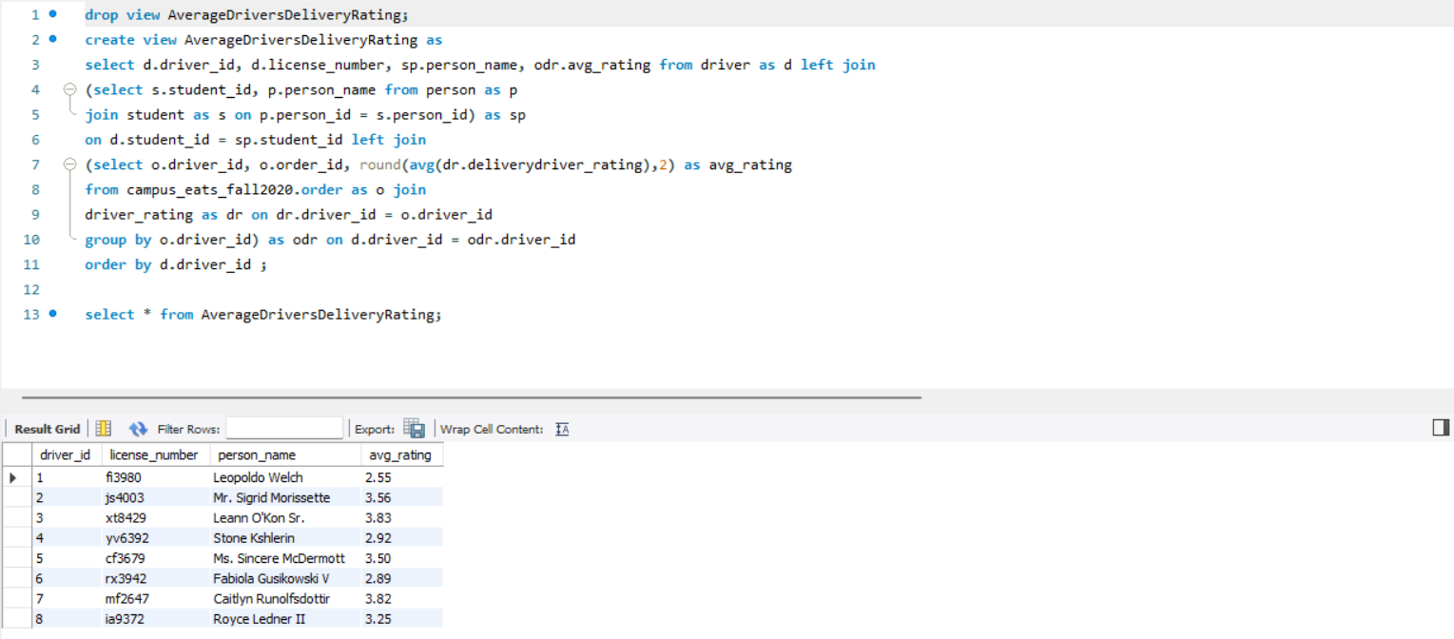
Views:
3. To get avg delivery rating of driver:

Slide 18
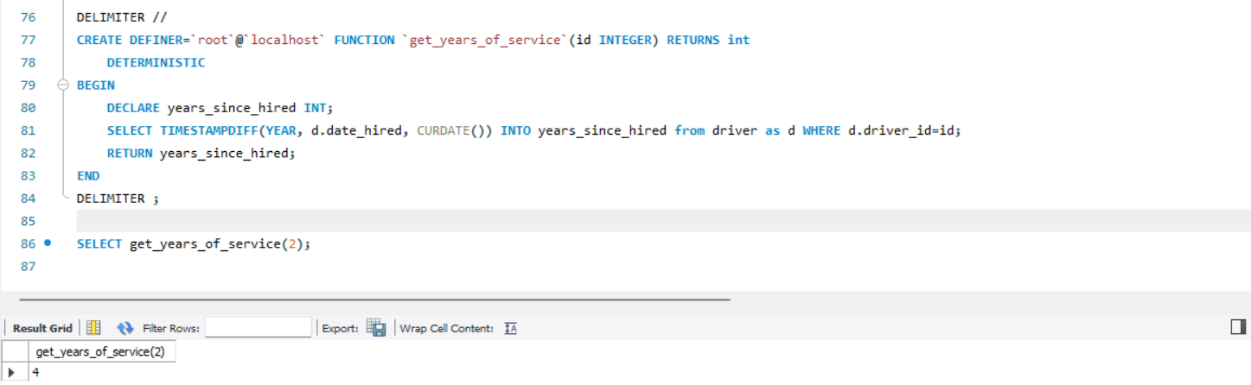
Functions:
1. To get years of service by driver_id:

Slide 19
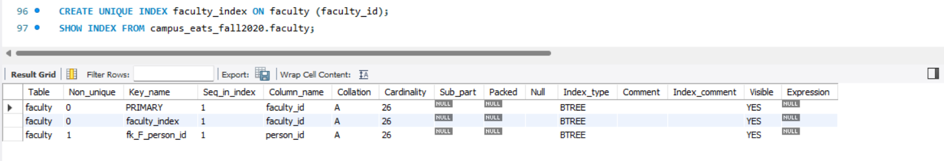
Indexes:
1. Index for faculty_id column in faculty table:

